Slide 1





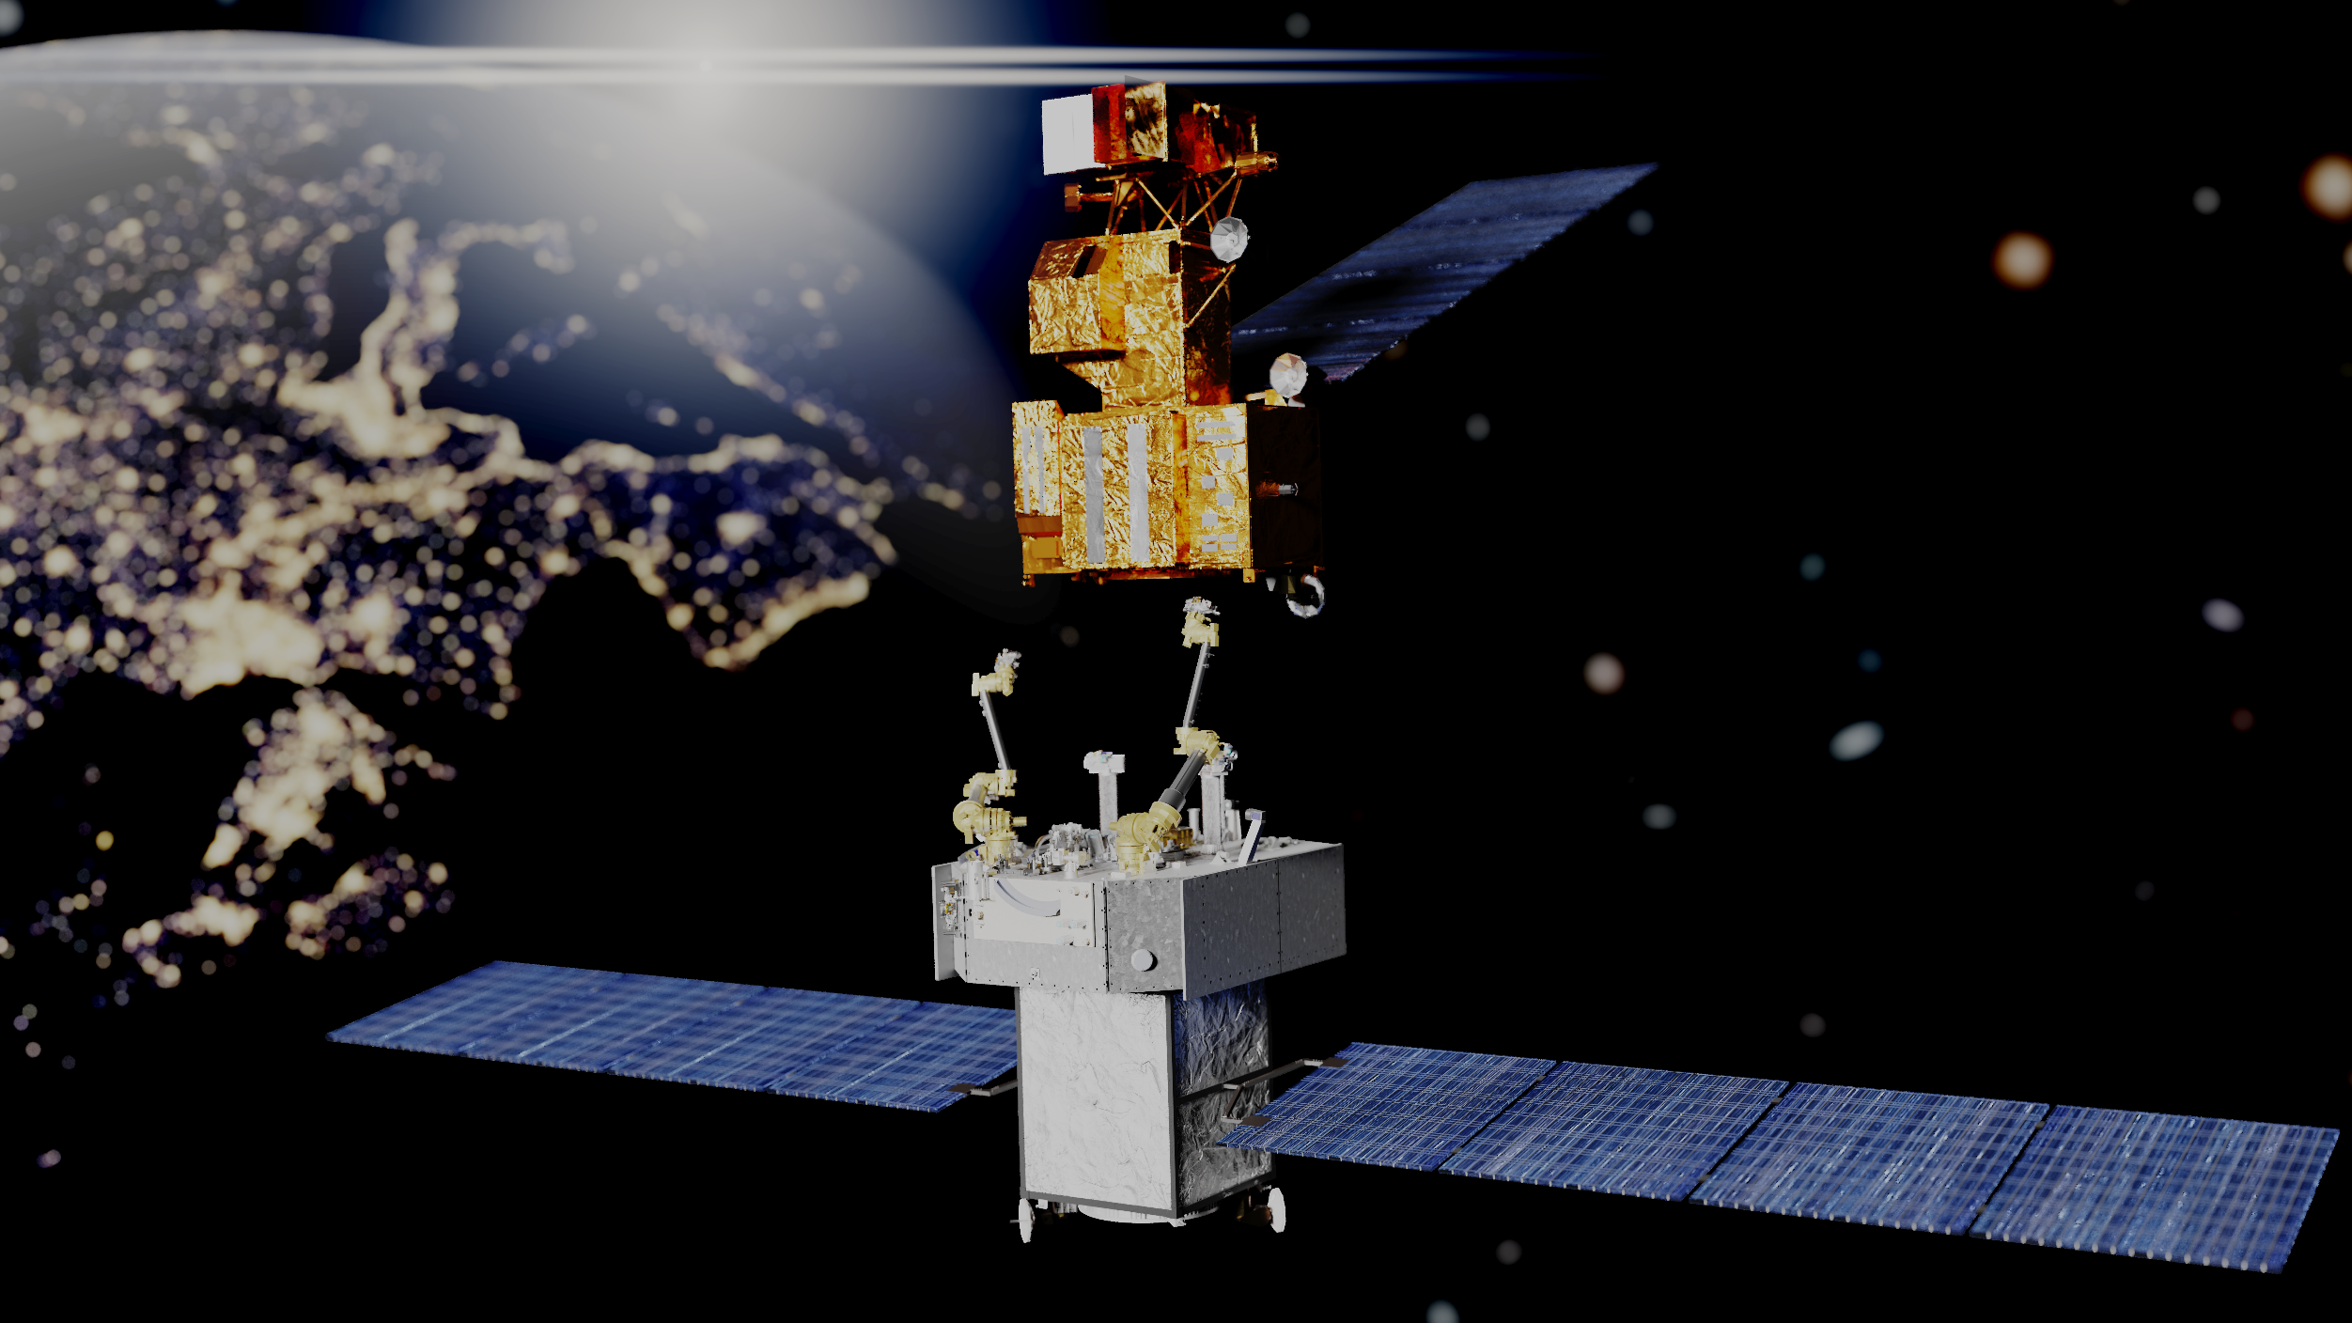
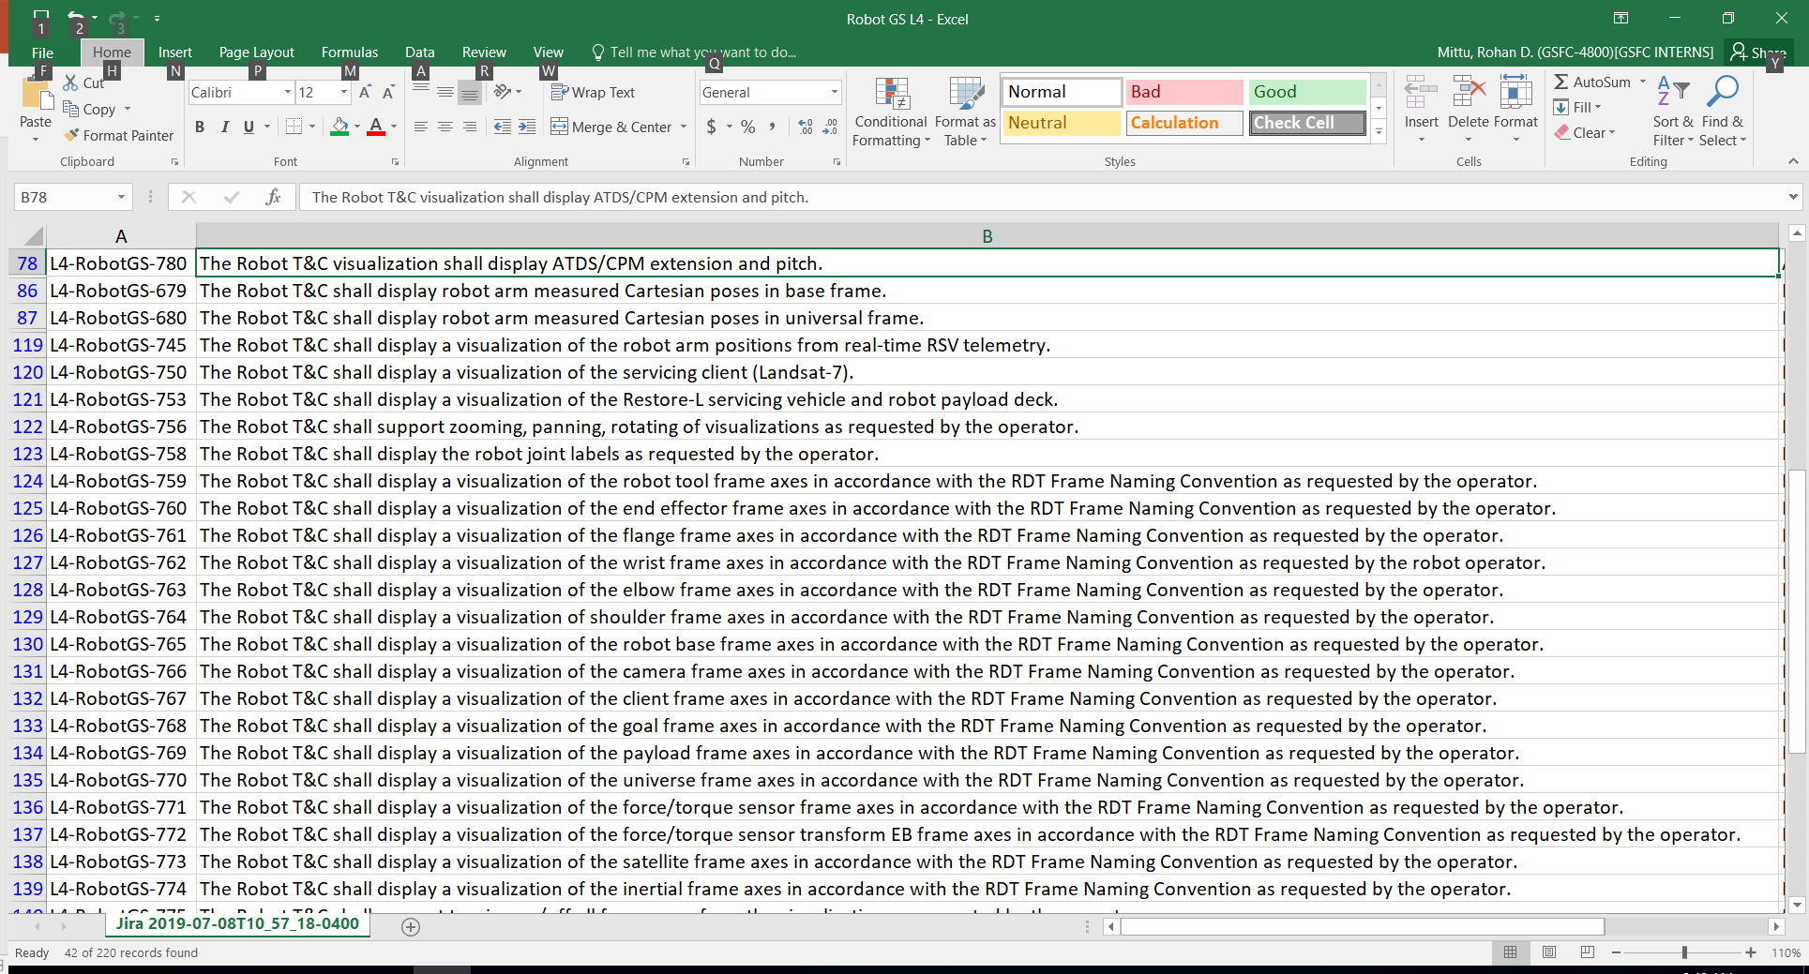
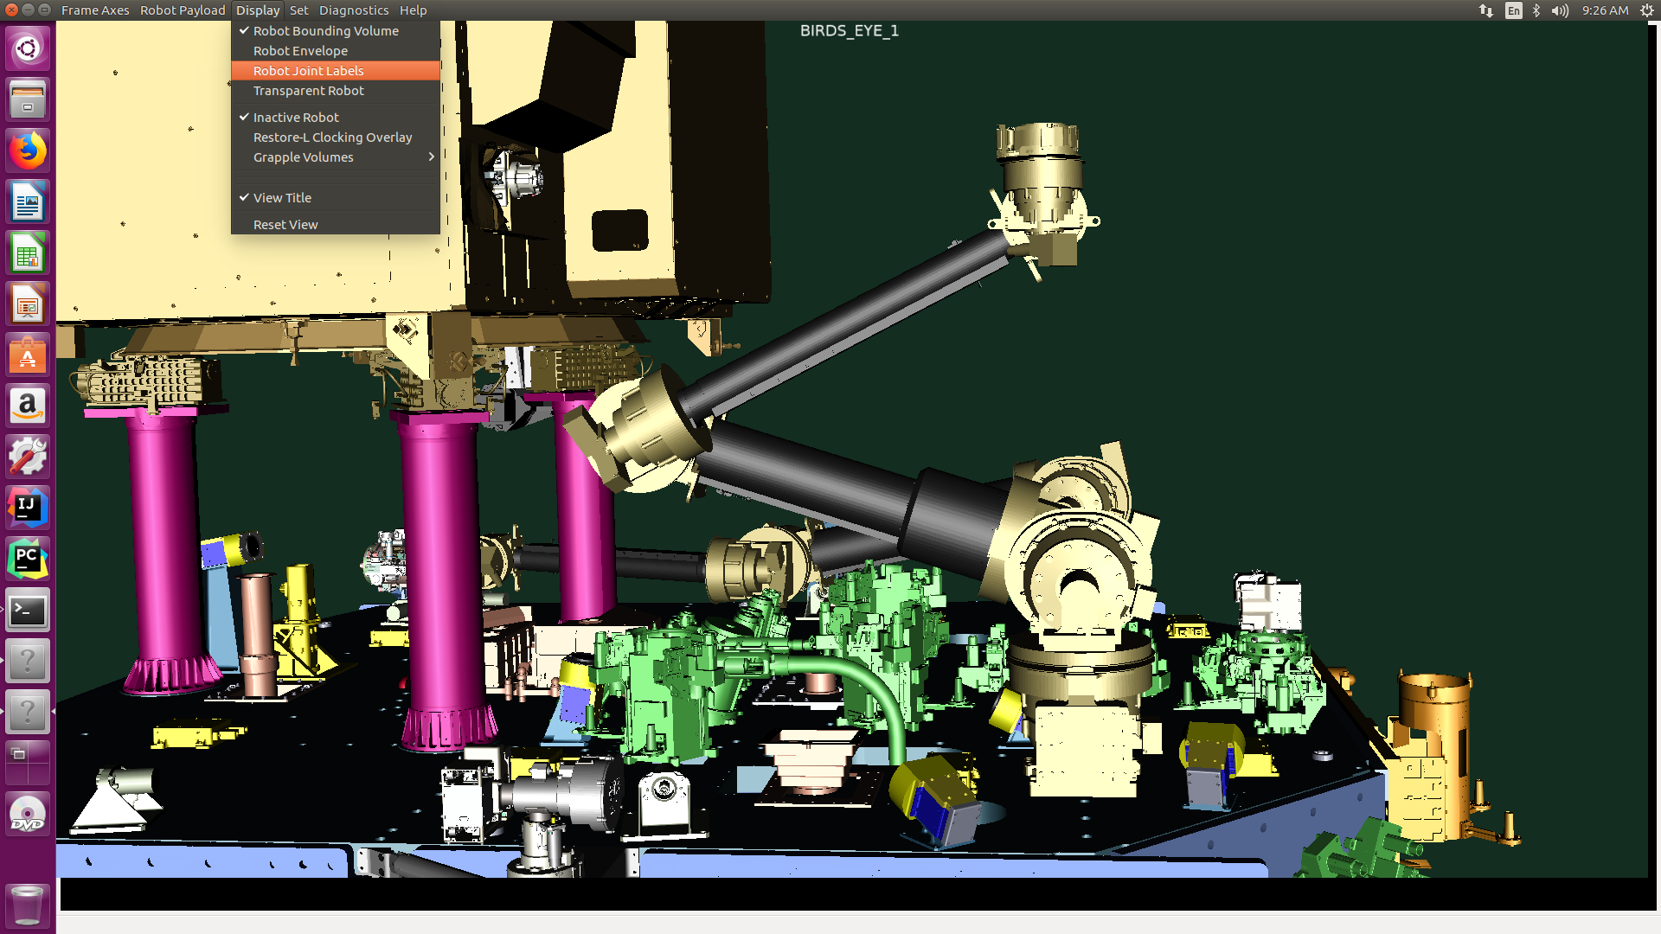
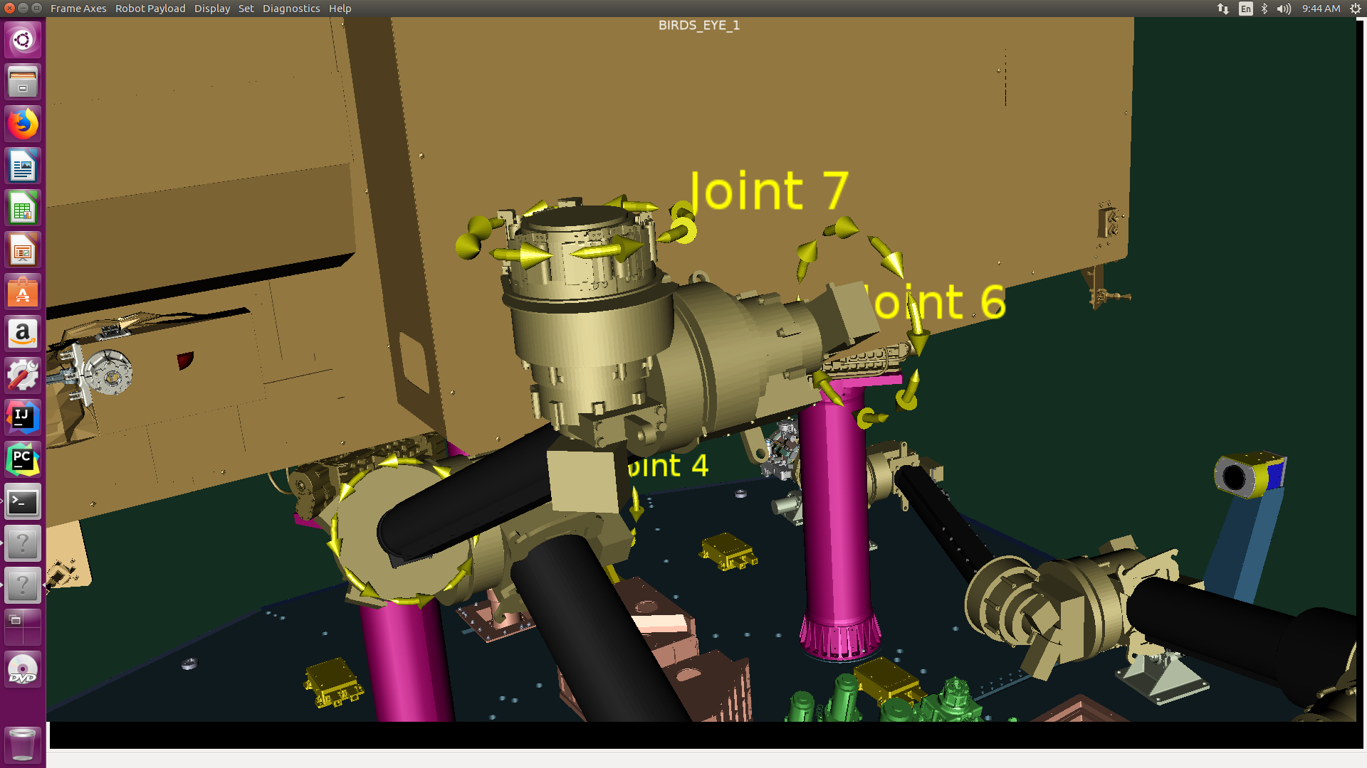
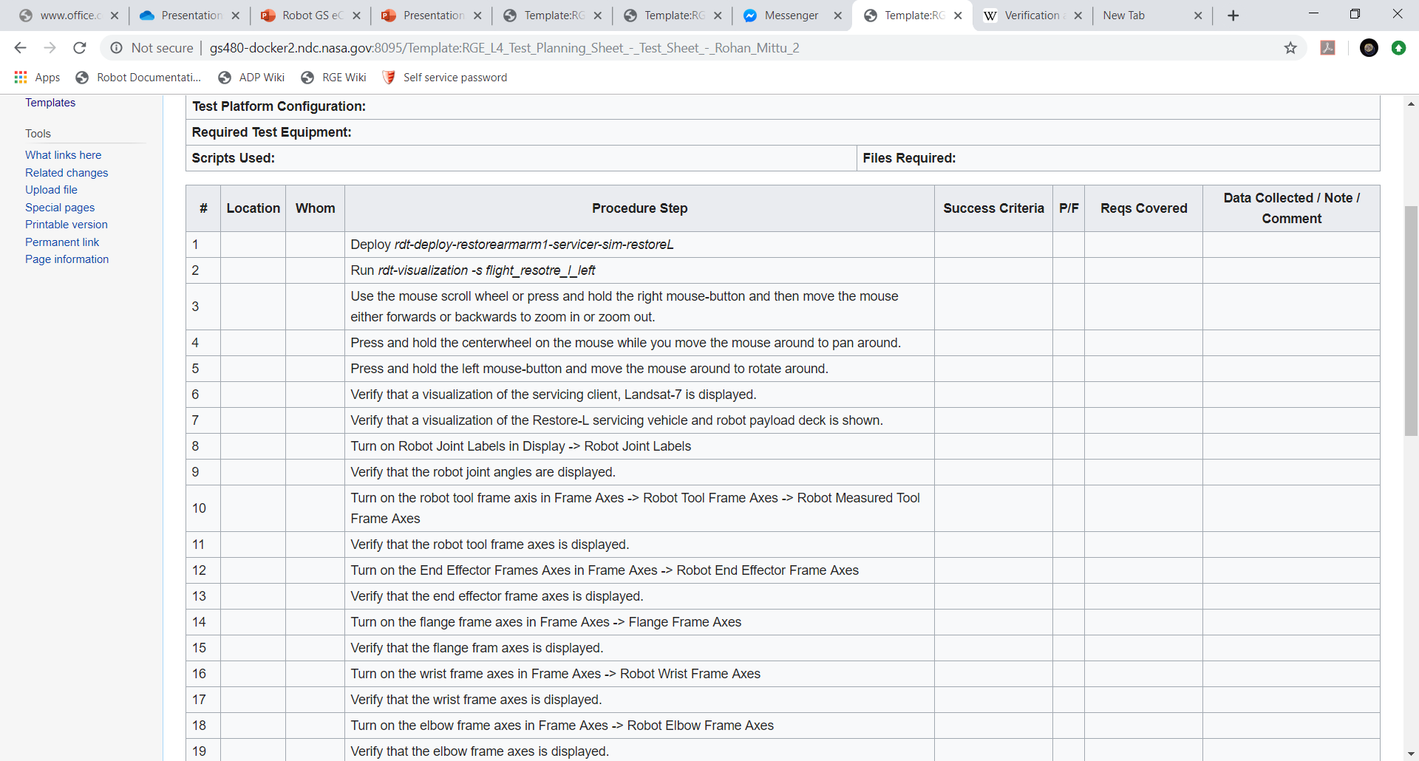
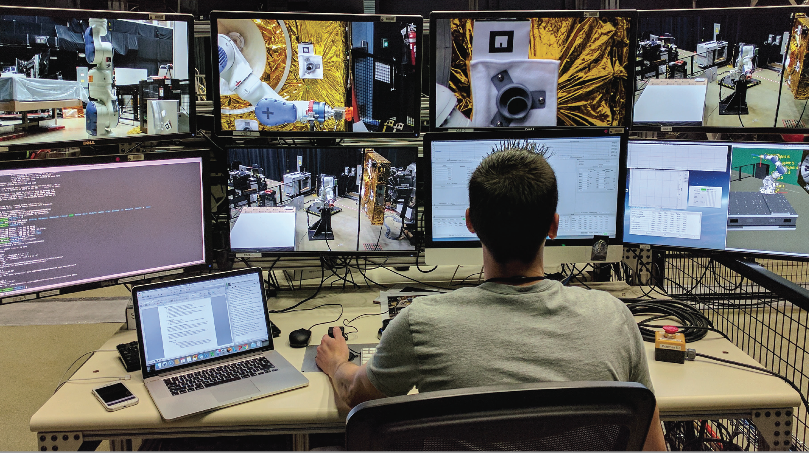
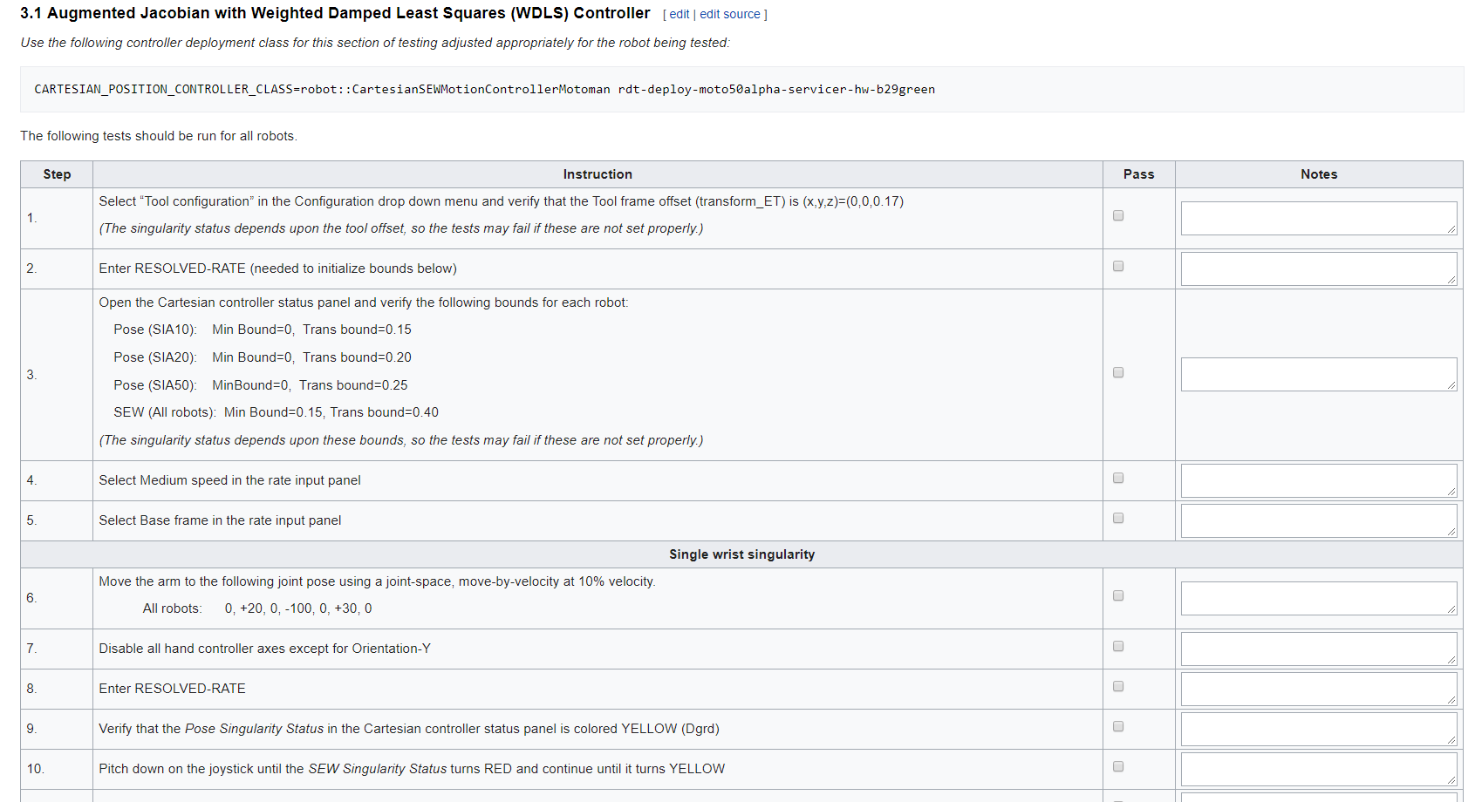
Robotics Ground Procedure Management and Requirements Testing
Rohan Mittu¹ and Joseph Wilkins²
¹Sherwood High School, Olney MD, ²University of Maryland, Baltimore County, Baltimore MD
Mentors: Vuong Ly, James Laporte, Zakiya Tomlinson
Category: Computer Science/IT
I. Restore-L Mission Overview
III. Verification and Validation (V&V) of Requirements Overview
V. Robot Ground System
Procedural Development
The Restore-L Mission’s goal is to perform in-space servicing of the Landsat 7 satellite. This servicing is required because the Landsat 7 satellite is almost out of the fuel needed to maintain a proper orbit. This will be the first effort by NASA to refuel a satellite that was not created to be refueled. This servicing includes performing an autonomous rendezvous, docking the Landsat 7 satellite on the Restore-L Payload, and performing tele-operated robotic operations that include the transfer of propellant. On the servicing payload there are two 7 degrees of freedom robotic arms each equipped with a multi-function tool drive system and tool cameras.
Product Verification demonstrates that an end-product complies with a regulation, requirement, specification, or imposed condition. Product validation confirms a verified end-product that has been integrated into the system fulfills its intended use and meets the needs of the customer and other identified stakeholders. There are 4 levels of requirements:
Level 4 is closest and most relevant to the Robot GS, consisting of subsystem requirements. Factory Acceptance Testing (FAT) is used to verify end-to-end functionality for operational use.
Level 3.5 and 3 deal with system and element requirements. Site Acceptance Testing (SAT) in the Mission Operations Center and Ground Readiness Testing (GRT) are conducted to confirm satisfaction of these requirements.
Level 2 requirements are verified by Mission Readiness Testing (MRT) and End-to-End Testing (ETE).
The goal of this project was to create procedures that will test the capabilities required by the Restore-L Robot Ground System. The test procedures need to thoroughly test all Restore-L Robot Ground System requirements. The requirements pertained to the SSPD Robot Team Algorithm Development Platform (ADP) software, which is used to provide the telemetry and command (ADP GUI) and visualization (ADP VIZ) of the robot system.
VI. Method of Procedural Development
The level 4 V&V requirements are categorized by the specific part of the Robot GS they apply to. One test procedure can verify a number of requirements within a specific category. The method used for developing a procedure is:
Group a number of requirements together that can most efficiently be tested together.
Run the corresponding part of the ADP software (Either the Visualization or GUI) to what requirements need to be tested.
Formulate a way to test the requirement, and take note of each step in doing so.
Create a MediaWiki page with the procedural steps noted using the ADP software.
Figure 1. Artist's concept of Restore-L autonomous rendezvous and docking (AR&D) Inset: Detailed diagram of the Restore-L robotic payload.
Figure 3. V&V Diagram with Requirement Levels.
II. Restore-L Robot Ground
System Overview
IV. Media Wiki
1
2
The Restore-L Robot Ground System (Robot GS) is one of seven systems that make up the Restore-L Ground Element (RGE). This system is responsible for the command and control of the robot arms, tool drive system and tool cameras. The Robot GS also includes video systems used during runtime operations and provides simulation support for planning and contingency operations.
MediaWiki is open-source software that is used for documentation of for a number of things including robot procedures. It is well-known for powering Wikipedia. Its benefits include:
Easy navigation with a visual editor
Security control and accessibility through user management
Creating templates with parameters,
Built in search
Ability to use plugins and extensions.
3
4
Figure 5. Method of development steps
VII. Acknowledgment
We would like to thank Brian Roberts for providing us the opportunity to intern at NASA GSFC this summer. We would like to thank our mentor, Vuong Ly, for his guidance through our work along with all of SSPD. We also thank NASA employees who have supported and taught us during our time here including James Laporte, Zakiya Tomlinson, and Jillianne Shear.
Figure 2. An operator at a robotic console controlling a Motoman robot arm.
Figure 4. An example Procedure for a SAT of the ADP Software in MediaWiki format.

